Slide 1
Introduction - Welcome
CS 2212B
Introduction to Software Engineering
Kostas Kontogiannis, Ph.D, P.Eng.
Professor, Computer Science
Notes:
This lesson introduces the basic steps in a software engineering project at a high level.
In practice, steps often overlap.

Slide 2
Welcome
Welcome to the Introduction to Software Engineering class!
I wholeheartedly wish you a very successful and productive academic term

Slide 3
Introduction
Software Engineering is a course that requires some work, but it will reward you not only with theoretical but also with hands-on knowledge in an area which is very much sought after and influences a myriad of applications which affect our every-day life.
The objectives of this course are:
To understand the basic principles, processes, techniques and tools for specifying, designing, implementing, testing, and maintaining software systems
To apply these basic principles, processes, techniques and tools through a term-long project with incremental deliverables

Slide 4
About the Instructor
Office: MC 375
E-mail: kkontogi@uwo.ca and cs2212b@uwo.ca
Office hours: Tuesday 9:00 – 10:00 (on-line via Zoom)
Thursday 17:00 – 18:00 (on-line via Zoom)
B.Sc. Applied Mathematics, U. Patras, Greece
M.Sc. Computer Science/AI, KUL, Belgium
Ph.D. Computer Science, McGill University, Canada
PostDoc Computer Science, U. Toronto, Canada
P.Eng. PEO – Software Engineering
Professor U. Waterloo, ECE (1997 – 2007)
NTUA, ECE (2007 – 2016)
Western, Comp. Sci. (2016 – ) – Western Research Chair

Slide 5

Textbook - Material
 | Software Engineering: A Practitioner's Approach 9th Edition By Roger Pressman and Bruce Maxim ISBN10: 1259872971 ISBN13: 9781259872976 https://www.mheducation.com/highered/product/1259872971.html
The electronic version of the textbook is accessible via the course’s Web site on OWL under the “McGraw-Hill Connect” menu option (see left-side banner towards the bottom end). Requires registration with McGraw-Hill.
We will be using OWL to host all the course content.
Eclipse (or a similar IDE of your choice) will be used for software development.
Depending on schedule and availability, DevOps tools such as BitBucket and Microsoft Teams will be used for group collaboration and source code version control. Instructions will be provided in the class and posted on OWL.

Slide 6
Course Schedule
Wednesday 10:30 – 11:30 (London ON. time)
Friday 10:30 – 12:30 (London ON. Time
Lectures will asynchronous and will be held on-line on Zoom.
In asynchronous mode, students watch the lecture videos and study the lecture notes in advance, and during lecture hours the instructor re-iterates and presents the key points, proceeds with discussion, and answers questions.
Check out the “Zoom” menu option in OWL for the meeting IDs

Slide 7
On-Line material
The course will be conducted in an on-line asynchronous mode.
Course content is structured and presented on a week-by-week basis.
The video lectures, the power point lecture notes, as well as the “live lecture” videos from the Fall offering are posted in advance in OWL so that you can “attend” the lecture and review the material ahead of time.
During the lecture hours, the instructor will quickly go over selected slides of the material, and students can ask questions related to the video and lecture notes pertaining to the week’s material.
You also have access to the electronic copy of your text book via the McGraw-Hill Connect menu in OWL.
Lecture hour meetings and office hour meeting will be conducted via Zoom.
Zoom meetings have already been set as links to OWL. You can access the Zoom meetings via the Zoom menu on the course’s Web site on OWL.

Slide 8
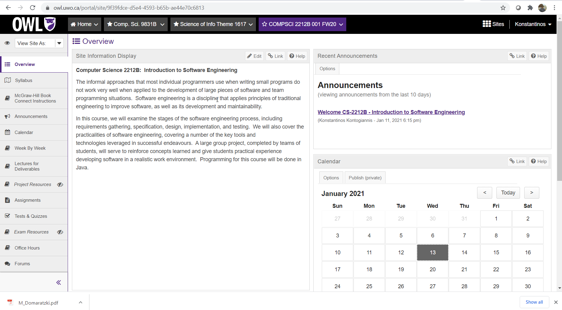
Owl Resources
Information on how to get access
to the electronic version of the book
All pptx and Mp4 lectures
organised on a week-by-week
basis
The lectures and videos which
are most relevant to your
deliverables
The Project description and useful
resources for the project
The description of each deliverable
D1-D4)
Tests and Quizzes to take on
specific dates.

Slide 9
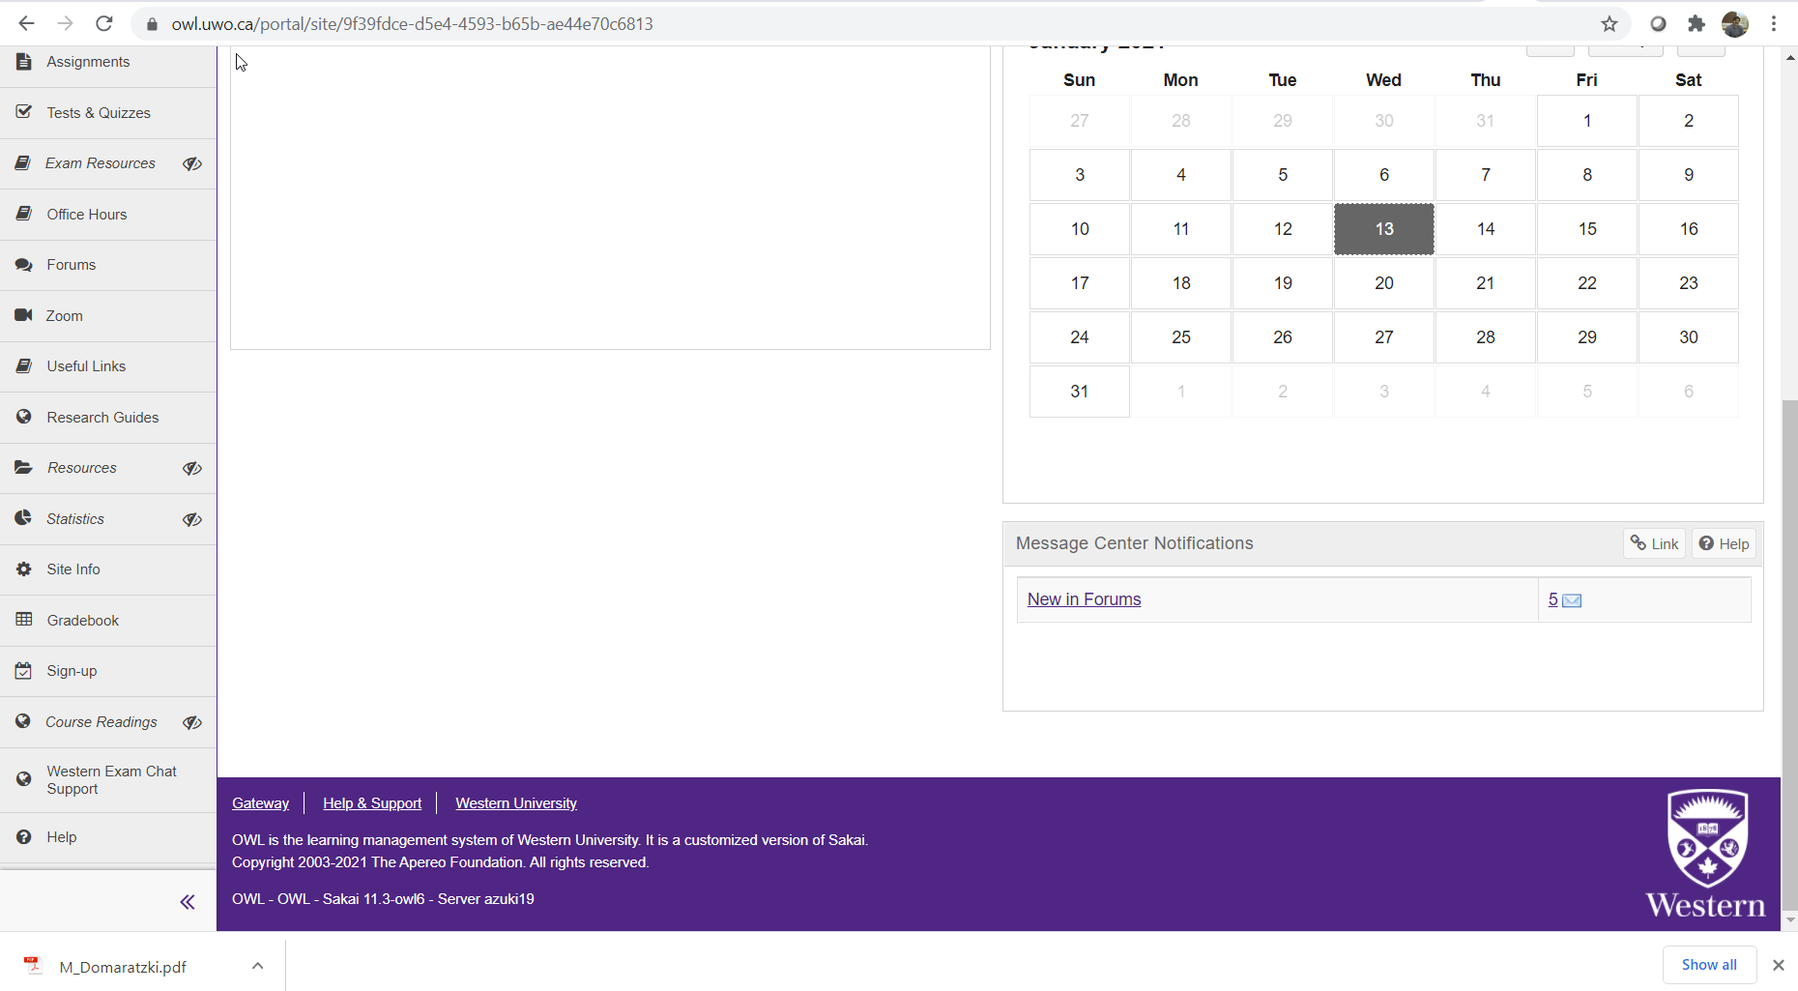
Zoom Links
Link to Zoom lecture hour meetings
and office hours meetings
Link to follow for registering to a group

Slide 10
Course Email account
All course related email inquiries have to be directed to:
cs2212b@uwo.ca
This email account is monitored only by the instructor and the TAs. Please do not send emails to the personal accounts of the instructor or the Tas.
Please send email to the personal email of the instructor only if you require confidential communication

Slide 11
Grading Plan and Project
Course project: 45%
Quizzes: 10% (5 short quizzes)
Midterm: 15% (on-line via Proctortrack or Zoom*)
Final: 30% (on-line via Proctortrack or Zoom*)
Course project:
Specify, design, and implement a system.
Teams of three students (please form groups
at OWL)
Four project deliverables:
Requirements specifications
documents (2) (Part 1 & Part 2)
Design document
Implementation (includes acceptance testing)
* Use of Proctortrack requires access to personal data. Details will be posted on course syllabus.

Slide 12
Subject Material
Chapter 1: Software and Software Engineering
Chapter 2: Process Models
Chapter 3: Agility and Process
Chapter 4: Recommended Process Model
Chapter 6: Principles That Guide Practice
Chapter 7: Understanding Requirements
Chapter 8: Quality Assurance and Testing
Chapter 9: Design Concepts
Chapter 10: Architectural Design—A Recommended Approach
Chapter 11: Component-Level Design
Chapter 14: Pattern-Based Design
Chapter 15: Quality Concepts
Chapter 16: Reviews—A Recommended Approach
Chapter 17: Software Quality Assurance
Chapter 19: Software Testing—Component Level

Slide 13
To-Do Check List for this Week
Form groups.
Login on OWL and select “Site Info” → “Groups you can join”.
Obtain access to the electronic copy of the book
Select the “McGraw-Hill Connect Instructions” menu option, download the instructions and follow the registration process
Watch the videos and go over the lecture notes and the URL links for the Parts related for Week 1 and 2. So that you will have a heads-up for next week’s lecture hours. You can refer to the Week-by-Week section of the class for which video parts to watch.
Checkout the project description. We will discuss it next week.
The project will be posted in the next few days. You can start working on it asynchronously.

